Slide 1

CAR SALES SYSTEM
Project Guide
Ms. Anagha Aher
GROUP MEMBER NAMES:
20104068 – Rohin Rajendra Ambati
20104064 – Prathamesh Sanjay Lambate
20104116 – Sarthak Sanjay More
20104117 – Kaushal Sanjay Nikam

Slide 2
Contents
Introduction
Objectives
Scope
Features / Functionality
Project Outcomes
Technology Stack
Block Diagram

Slide 3
1. Introduction
In the existing system, it is difficult to discrete each car information
and provide it to the buyer who are interested to purchase them.
In the proposed system, the application can manage the details of the car.
With this customer can get information quickly as details of the car that came clearly.

Slide 4
2. Objectives
To build a user friendly website.
To provide relevant details to the user about cars.
To create a platform which includes reviews, ratings
and comparisons to help the user choose the best
models.
To achieve an efficient and effective domain for car
sales system.

Slide 5
3. Scope
User can select car types, brands with the help of features,
prices, ratings, etc.
User can sell old car through preferred market value.
Test Drive option are aslso available providing wide range of options for different cars.

Slide 6
4. Feature /Functionality
1. Feature 1 :
It will be convenient for the user when it comes to
purchasing or reselling a vehicle.
2. Feature 2 :
The webpage design will give full functionality and
offer maximum information about the vehicle on their
tips of tech devices.
3. Feature 3 :
Offers a responsible and attractive system, also defining
the vehicle categories clearly with the help of images
and customer views.

Slide 7
4. Features 4 :
  Our system provides the user various option for deciding types of car and also their brands.
5. Features 5 :
  User can also sell his old car through its appropriate market value.

Slide 8
5. Outcome of Project
User can login at web page using user ID and password
User can search for options available i.e login, create
new account, register, etc.
User can buy a car providing following details :
Identity proof such as pan card, driving license, etc.
Address proof such as aadhaar card, electricity bill, etc.
Income proof such as bank statements for last six months /
last three month’s salary slips.

Slide 9
6. Technology Stack
1. MySQL – We have used MySQL database in this
project.
Apache Netbeans 8.2 – We have used Apache Netbeans 8.2
to creae design using JAVA and
MySQL
Jdk 16.0.2

Slide 10
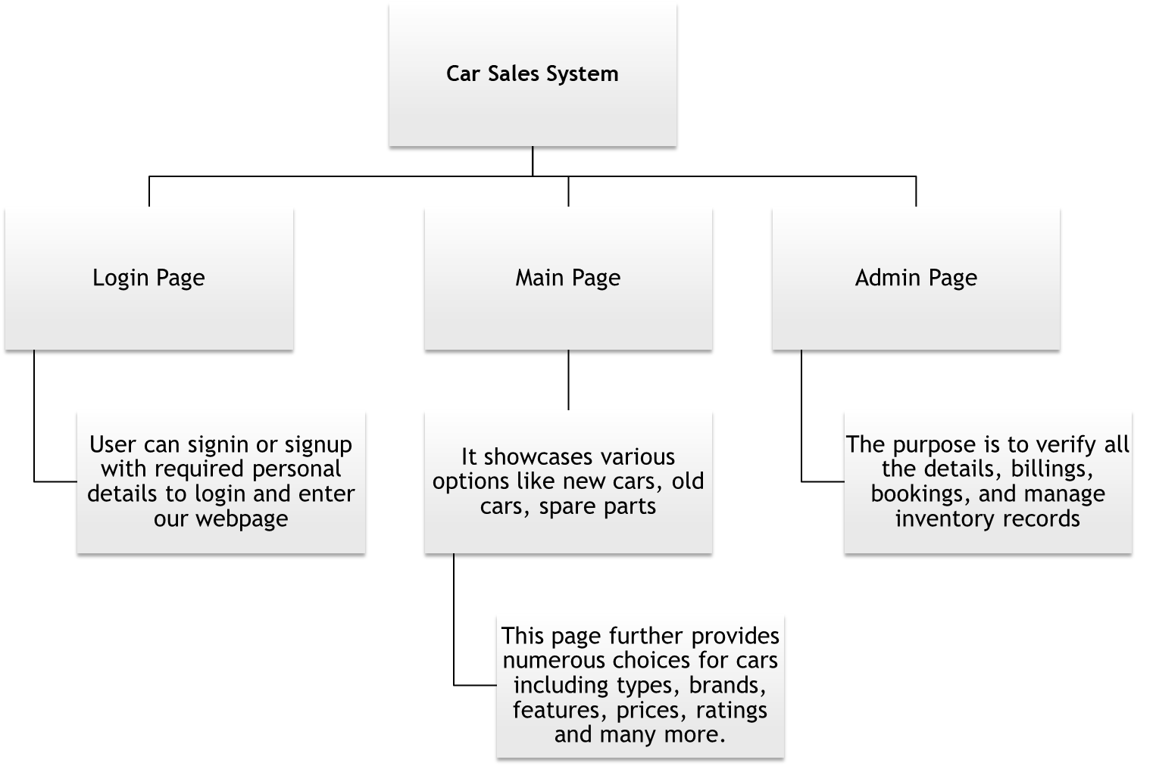
Block Diagram

Slide 11
Thank You...!!

